Slide 1

Machine Learning Mini Project BACHELOR OF TECHNOLOGY in COMPUTER SCIENCE AND ENGINEERING (Affiliated to Dr. A.P.J. Abdul Kalam Technical University, Lucknow) ACADMIC SESSION (2020-2021)
Sanskar College of Engineering and Technology, Ghaziabad.
Presented By:
Anand Kumar Kandu
B.tech – V Semester
Roll No: 1821510004
Submitted to:
Mrs. Sony Kumari

Slide 2
TABLE OF CONTENTS
Introduction
Objective
Machine Learning Project Life Cycle
Feature Engineering
Linear regression
Error Analysis of the Model
Model Performance
Bibliography

Slide 3
Introduction
Machine Learning:
“Machine learning (ML) is the study of computer algorithms that improve automatically through experience. It is seen as a subset of artificial intelligence.
Machine learning is a sub-domain of computer science which evolved from the study of pattern recognition in data, and also from the computational learning theory in artificial intelligence. It is the first-class ticket to most interesting careers in data analytics today. As data sources proliferate along with the computing power to process them, going straight to the data is one of the most straightforward ways to quickly gain insights and make predictions.
In this project there is a real word data set is given, data set have multiple features. All features is a numerical values. After analyzing the data and making it comfortable to learn by the machine we have to tarin a linear regression efficient model which should be able to make a clear and correct prediction.

Slide 4
Objective
To make a business model.
This model help to company to predict correct price.
To analyze risks and benefits.
To analyze that which feature is more important to fulfil the need of the client and highly correlated.

Slide 5
Machine Learning Project Life Cycle
Machine learning life cycle involves seven major steps, which are given below:
Gathering Data
Data preparation
Data Wrangling
Analyze Data
Train the model
Test the model
Deployment

Slide 6
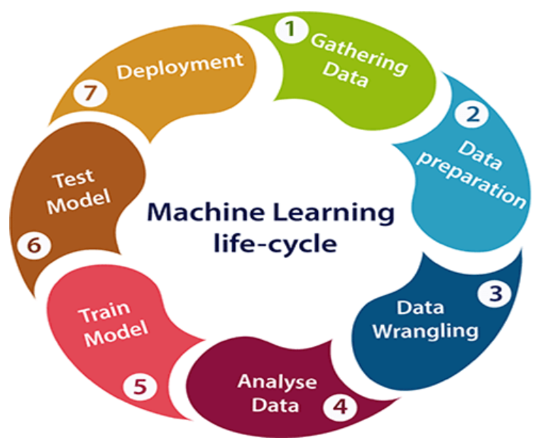
Machine Learning Project Life Cycle
Machine learning life cycle involves seven major steps, which are given below:

Slide 7
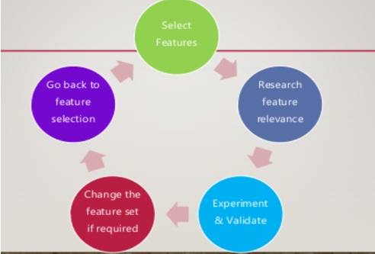
Feature Engineering:
Feature engineering is the process of using domain knowledge to extract features from raw data via data mining techniques. These features can be used to improve the performance of machine learning algorithms. Feature engineering can be considered as applied machine learning itself.

Slide 8
Feature Engineering Process:
Feature engineering evolves multiple process:
Brainstorming or testing features
Deciding what features to create
Creating features
Checking how the features work with your model
Improving your features if needed
Go back to brainstorming/creating more features until the work is done

Slide 9
Linear Regression :
Linear regression most popular Supervised Machine Learning algorithms. It is a statistical method that is used for predictive analysis. Linear regression makes predictions for continuous/real or numeric variables such as sales, salary, age, product price, etc.
Y = βo + β1X + ∈
where, Y - Dependent variable
X - Independent variable
βo - Intercept
β1 - Slope
∈ - Error
βo and β1 are known as coefficients. This is the equation of simple linear regression. It's called 'linear' because there is just one independent variable (X) involved. In multiple regression, we have many independent variables (Xs). If you recall, the equation above is nothing but a line equation (y = mx + c)

Slide 10
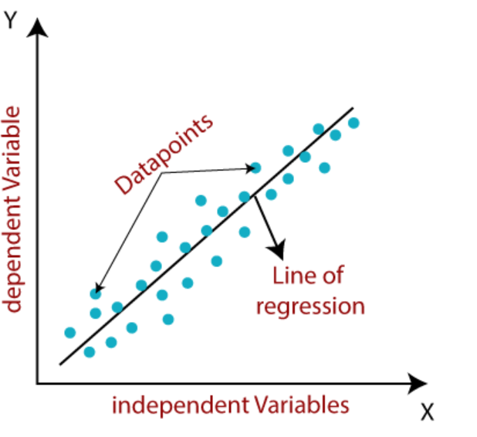
Linear Regression :

Slide 11


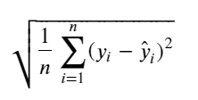
Regression Evaluation Metrics:
Mean Absolute Error (MAE): is the mean of the absolute value of the errors:
Mean Squared Error (MSE): is the mean of the squared errors:
Root Mean Squared Error (RMSE): is the square root of the mean of the squared errors:
MAE is the easiest to understand, because it's the average error.
MSE is more popular than MAE, because MSE "punishes" larger errors, which tends to be useful in the real world.
RMSE is even more popular than MSE, because RMSE is interpretable in the "y" units.

Slide 12

Model Performance:
In statistics, the coefficient of determination, denoted R2 or r2 and pronounced "R squared", is the proportion of the variance in the dependent variable that is predictable from the independent variable(s).
this metric explains the percentage of variance explained by covariates in the model. It ranges between 0 and 1. Usually, higher values are desirable but it rests on the data quality and domain. For example, if the data is noisy, you'd be happy to accept a model at low R² values. But it's a good practice to consider adjusted R² than R² to determine model fit.
where, SSres = Explained variation
SStot = Total Variation
R-squared is a statistical method that determines the goodness of fit.

Slide 13
Bibliography
Following are the various references used in the preparation of this project
https://www.hackerearth.com/practice/machine-learning/prerequisites-of-machine-learning/basic-probability-models-and-rules/tutorial/
https://en.wikipedia.org/wiki/Linear_regression
https://scikitlearn.org/stable/modules/generated/sklearn.linear_model.LinearRegression.html
https://matplotlib.org/
https://www.geeksforgeeks.org/image-classifier-using-cnn/
https://www.javatpoint.com/linear-regression-in-machine-learning

Slide 14
Thank You

